Slide 1


NSOP 2024
Commanders Briefing
Air Force ROTC Detachment 842
The University of Texas at San Antonio
C/Llanas, C/Parry, & C/Griffin
19 Aug 24

Slide 2


Overview
NSOP Schedule
Group Rotations
NSOP Set-Up Visuals
Campus Tour
Leads/Volunteers
Reserved Rooms
Logistics
Summary
Questions
Air Force ROTC Detachment 842 • We Build Exceptional Officers • The University of Texas at San Antonio

Slide 3
NSOP Schedules
Aug 22nd – Main Auditorium (Cadre Led):
0700-0755: Volunteers Arrive/Set-Up
0730-0900: In-Processing (First Floor)
Height & Weight
Computer Check-In Desk
Transition to Ground Floor Auditorium - Rm 0.212
Overflow Room: 1.120
0905-0920: Commander’s Introduction/Intent
0925-1140: Cadre Introductions/Paperwork/Wings Breakdown
1145-1200: Questions for Cadre
1200: Prospects Dismissed
1205-1300: Volunteers Clean-Up
Aug 23rd – Main Auditorium (Cadet Led):
0700-0755: Volunteers Arrive/Set-Up
0730-0900: In-Processing/Check-In (Ground Floor)
Schreiner/Friday Only Prospects
Height & Weight
Computer Check-In Desk
Transition to Main Auditorium - Rm 0.104
Second Day Prospects
Main Auditorium: Flight Time/Introductions
0900-0910: Wrap Up Flight Time/Transition To Rotations
0915-1140: Group Rotations
1145-1155: Wrap Up Rotations/Transition To Main Auditorium
1200-1300: Club/Wingstaff Introductions (8 min. max)
1300: Prospects Dismissed
1305-1400: Volunteers Clean-Up
Air Force ROTC Detachment 842 • We Build Exceptional Officers • The University of Texas at San Antonio

Slide 4
Group Rotations
0915 – 1000:
Groups A/B/C:
Room 1.126 – GLP/Waiting
Room 1.122 – Sports Physicals if needed
Groups D/W/X: Room 1.124 – LRS
Dress & Appearance Walkthrough
Groups Y/Z: Upstairs Outside Platform – Tour
1005 – 1050:
Groups Y/Z:
Room 1.126 – GLP/Waiting
Room 1.122 – Sports Physicals if needed
Groups A/B/C: Room 1.124 – LRS
Dress & Appearance Walkthrough
Groups D/W/X: Upstairs Outside Platform – Tour
1055 – 1140:
Groups D/W/X:
Room 1.126 – GLP/Waiting
Room 1.122 – Sports Physicals if needed
Groups Y/Z: Room 1.124 – LRS
Dress & Appearance Walkthrough
Groups A/B/C: Upstairs Outside Platform – Tour
Groups A/B/C Guide: C/Vallor
Groups D/W/X Guide: C/Branson
Groups Y/Z Guide: C/Superales
Air Force ROTC Detachment 842 • We Build Exceptional Officers • The University of Texas at San Antonio

Slide 5
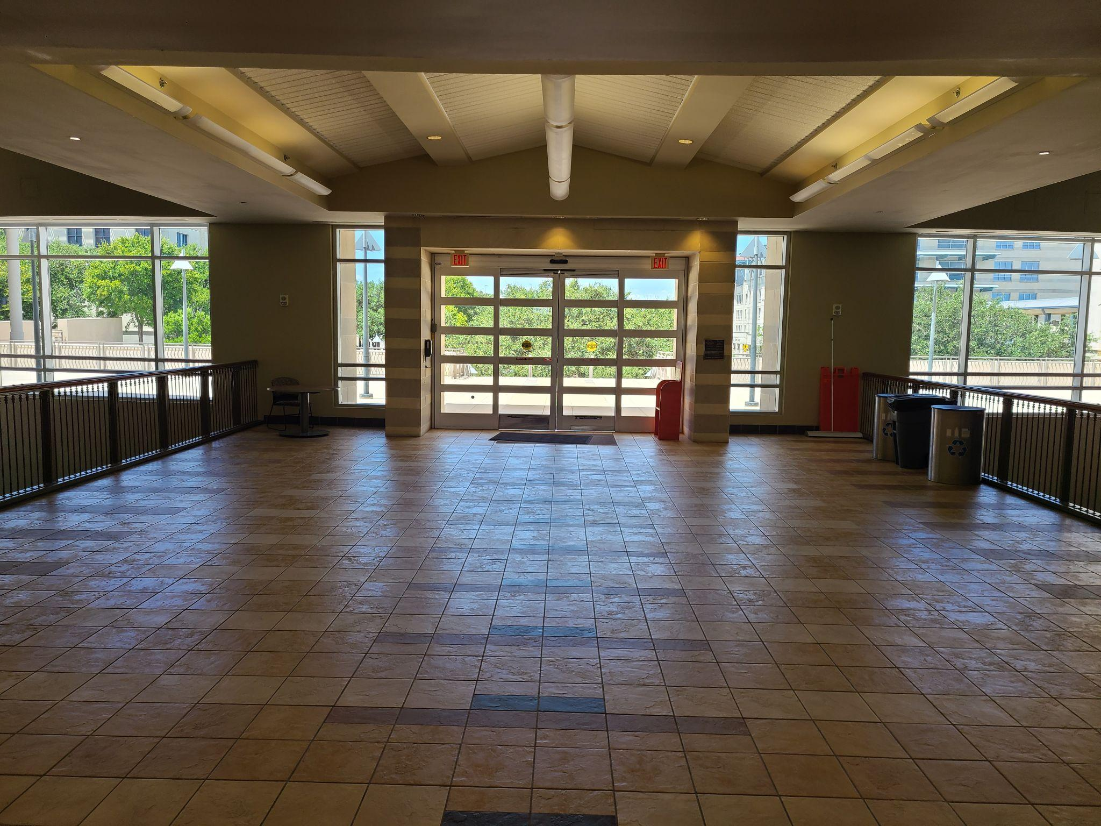
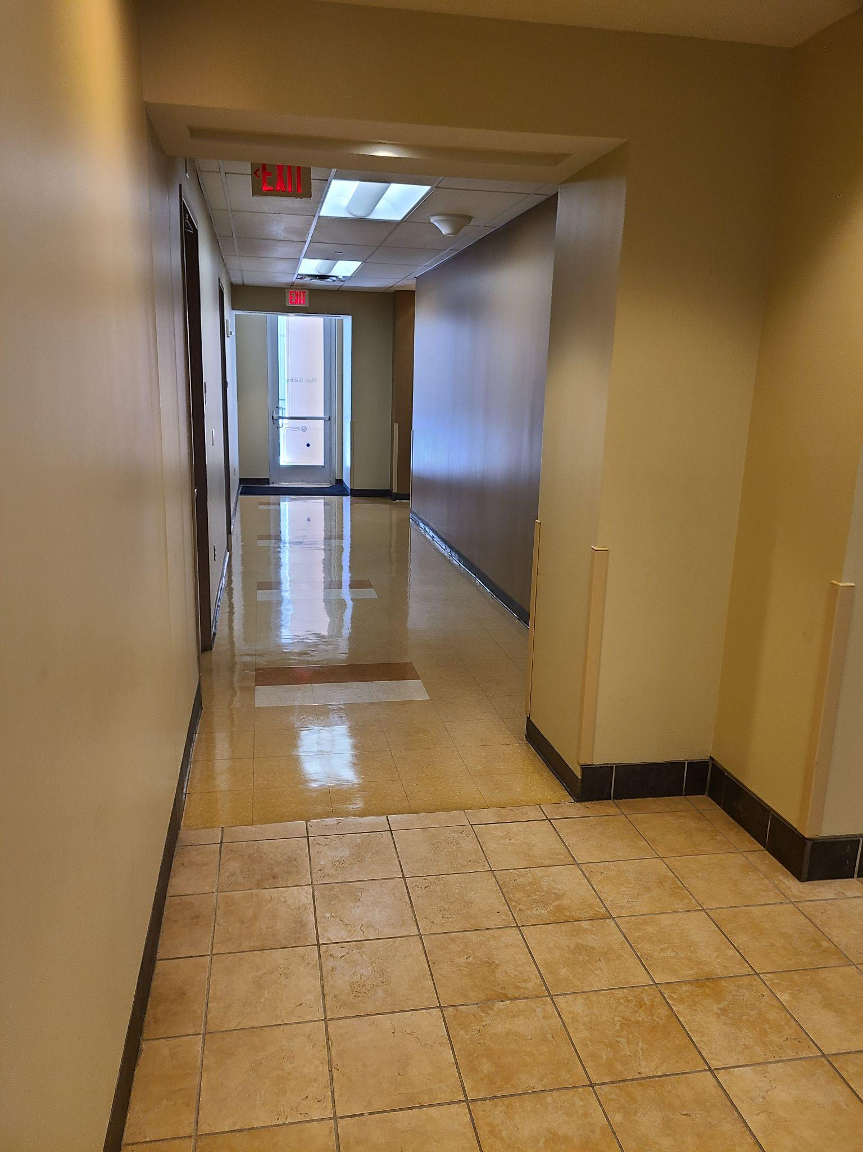
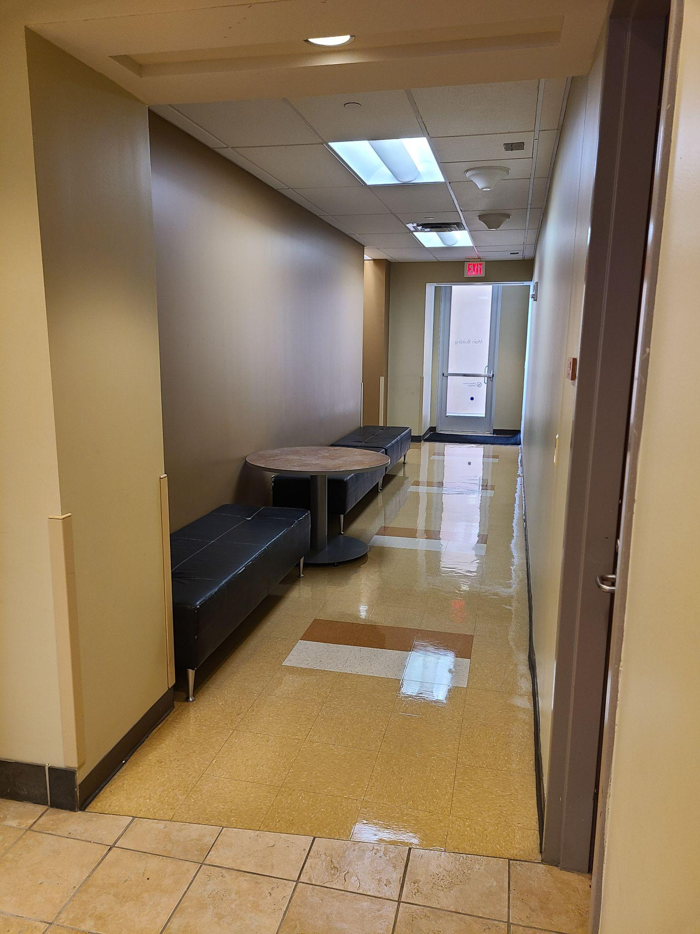
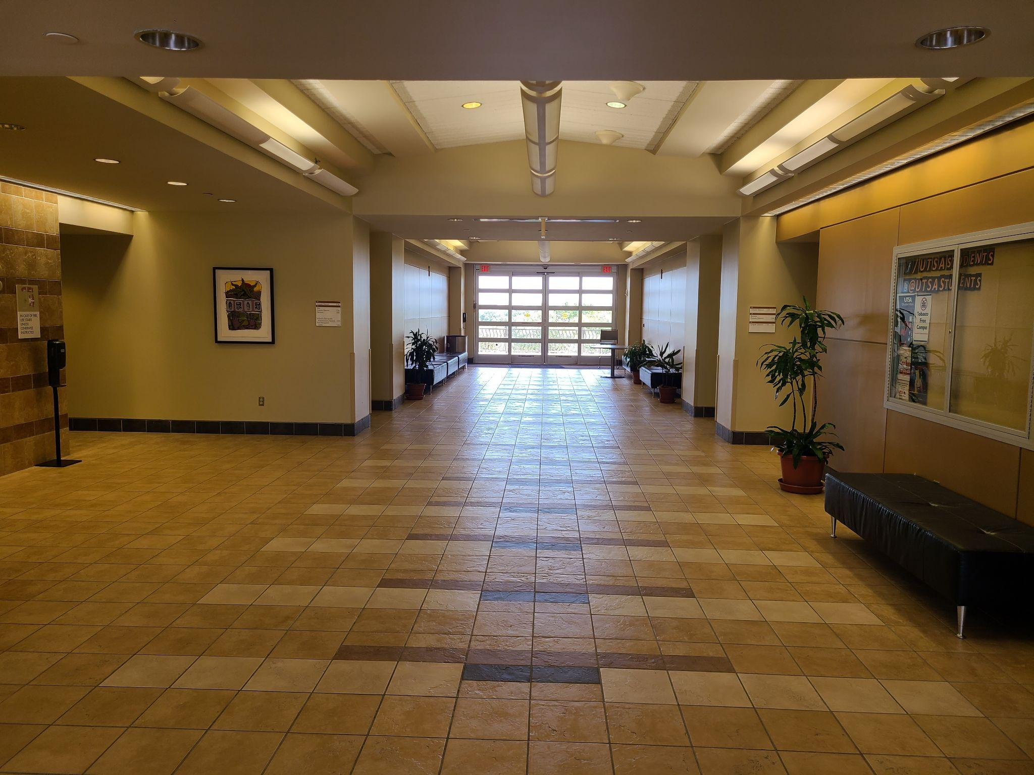
Thursday Set-Up Visual
Air Force ROTC Detachment 842 • We Build Exceptional Officers • The University of Texas at San Antonio

Slide 6
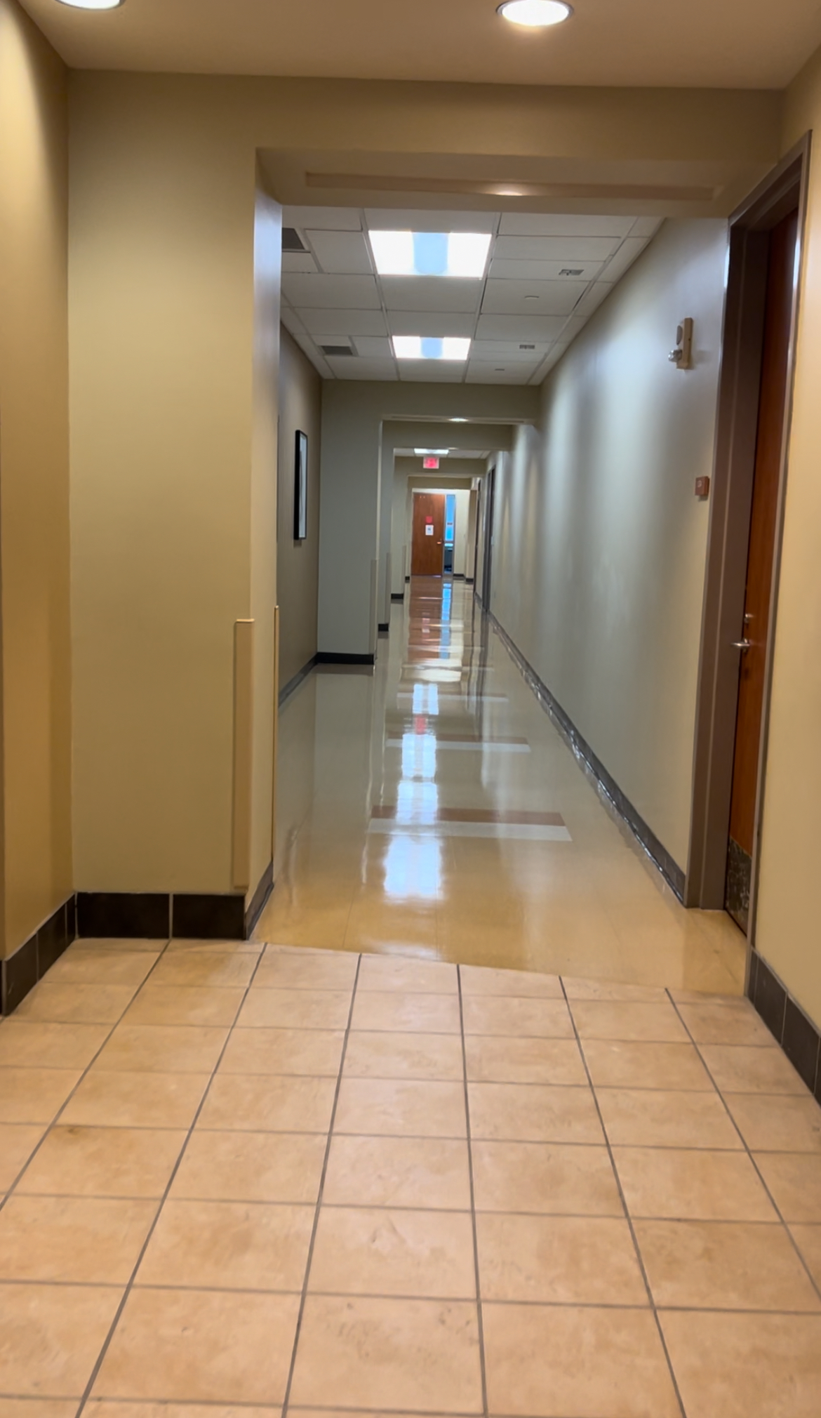
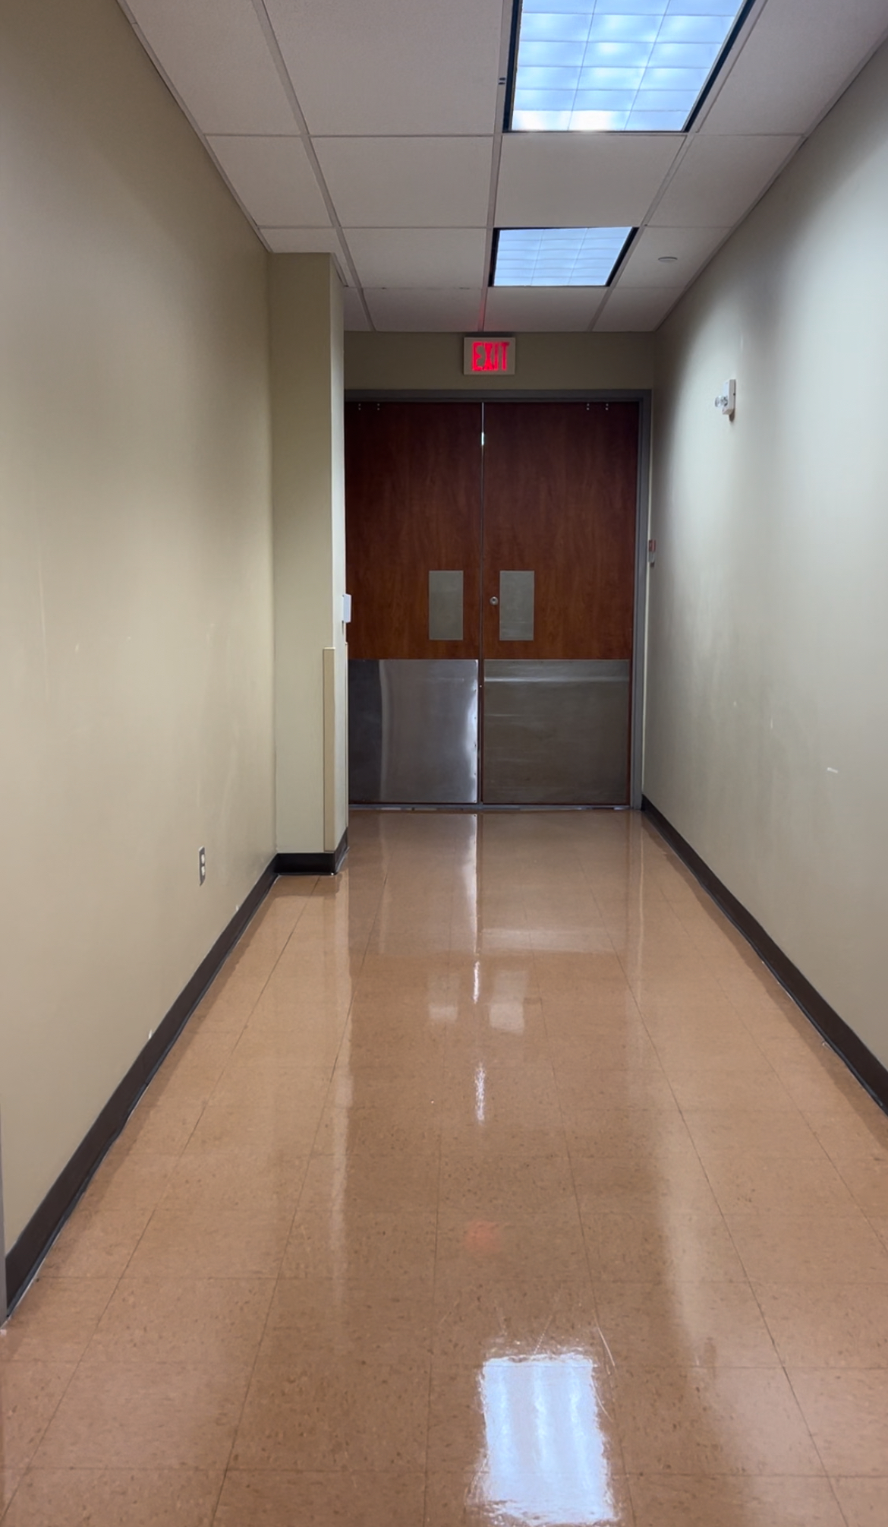
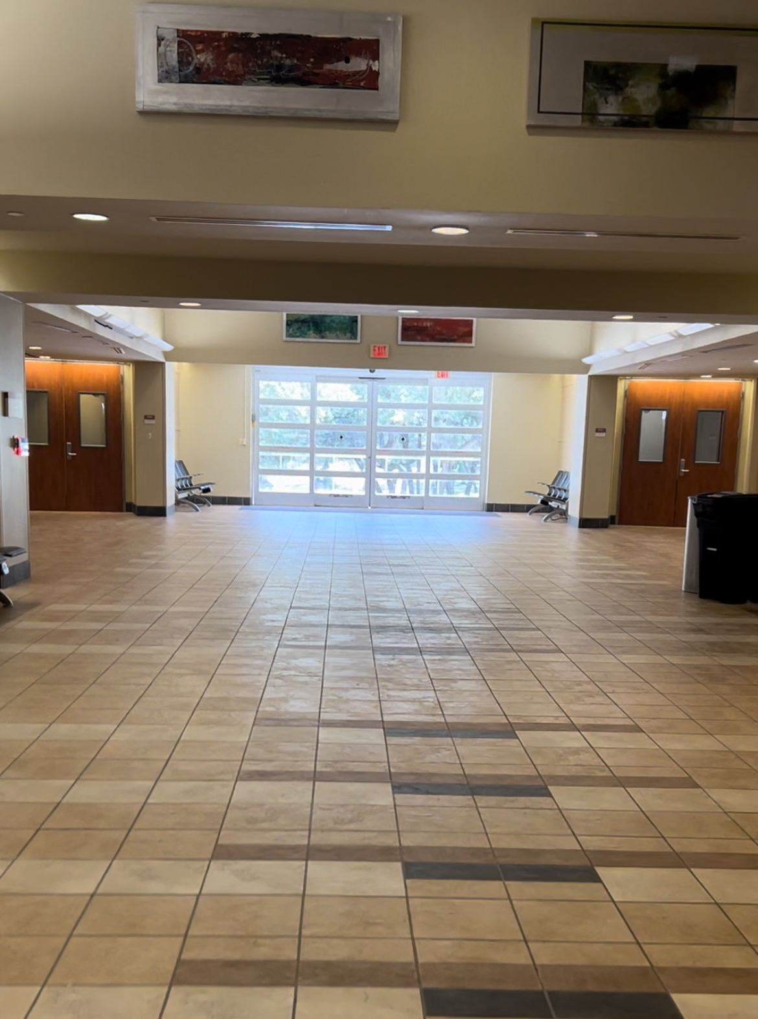
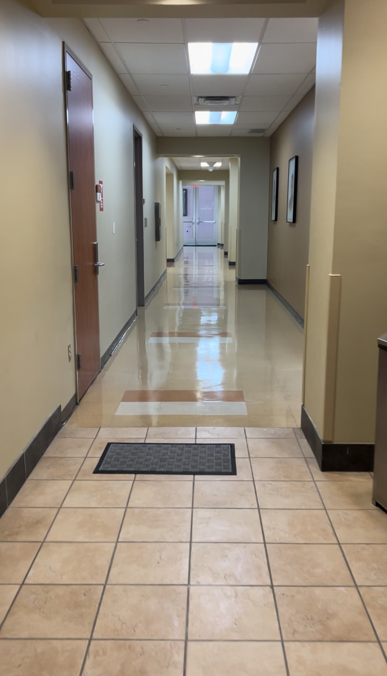
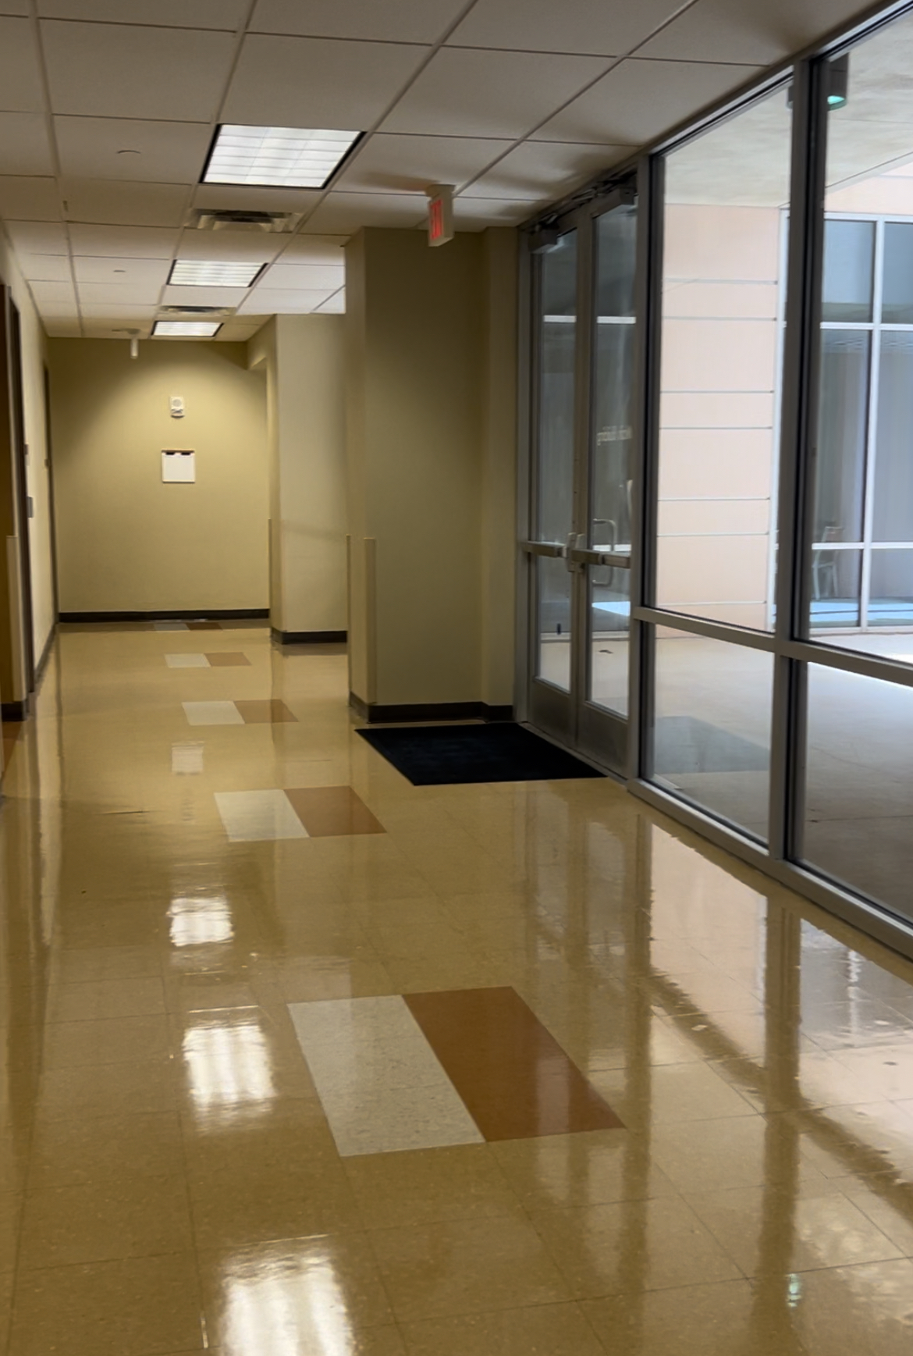
Friday Set-Up Visual
Air Force ROTC Detachment 842 • We Build Exceptional Officers • The University of Texas at San Antonio

Slide 7
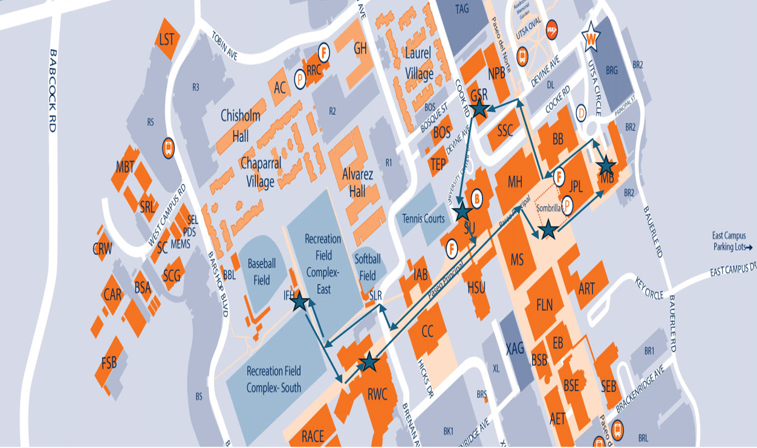
Campus Tour
Tour Directions:
Main Building -> Detachment -> Student Union -> Rec Fields -> Rec Center -> Sombrilla -> Main Building
Air Force ROTC Detachment 842 • We Build Exceptional Officers • The University of Texas at San Antonio

Slide 8
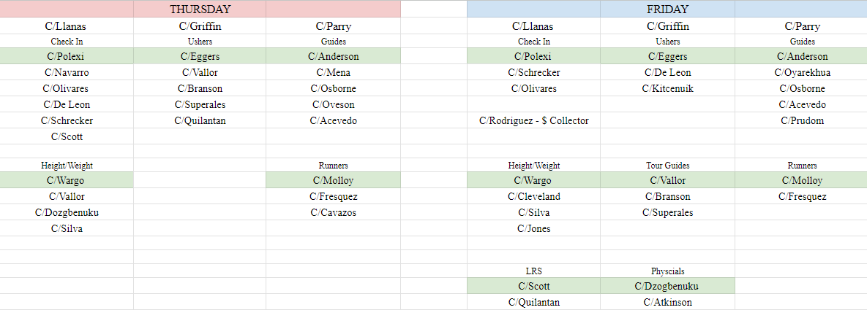
Leads/Volunteers
Air Force ROTC Detachment 842 • We Build Exceptional Officers • The University of Texas at San Antonio

Slide 9
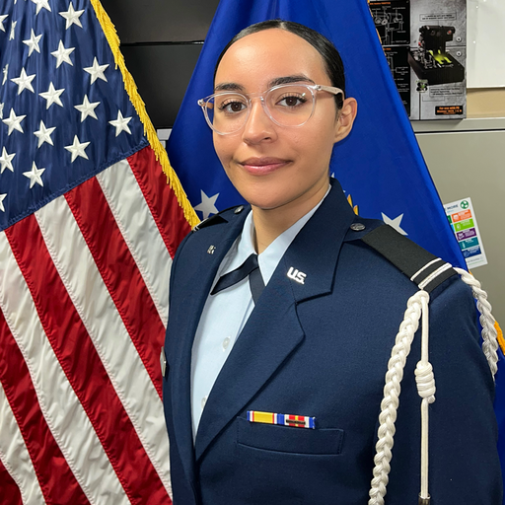
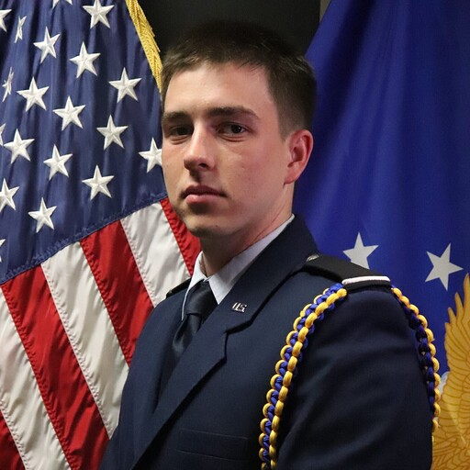
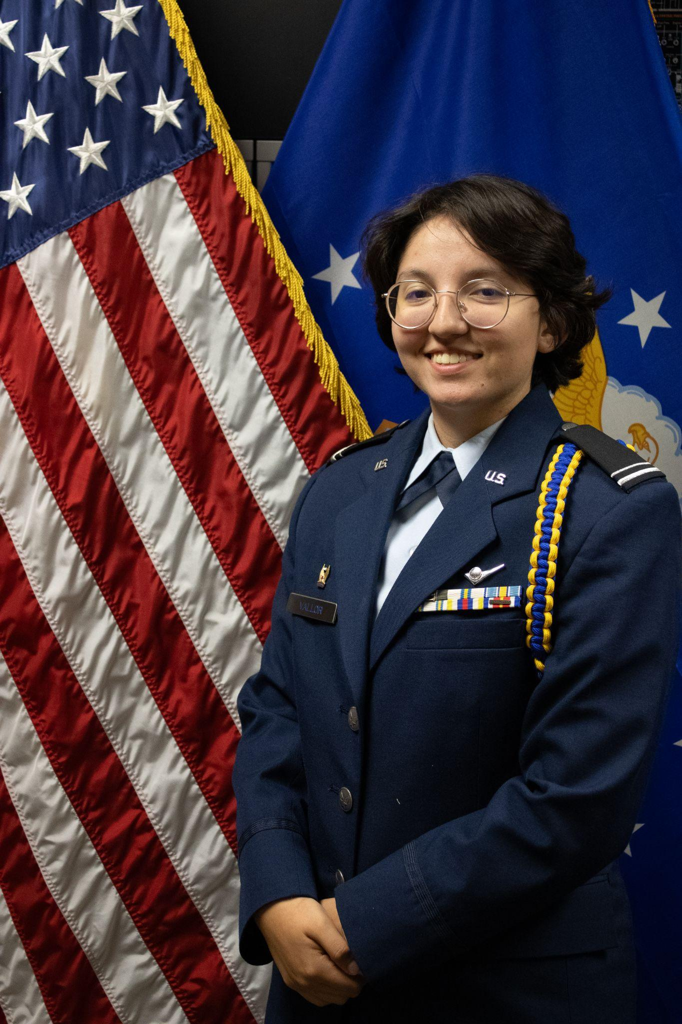
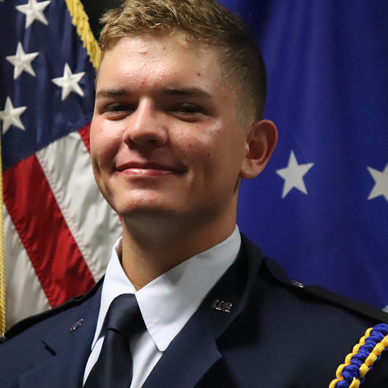
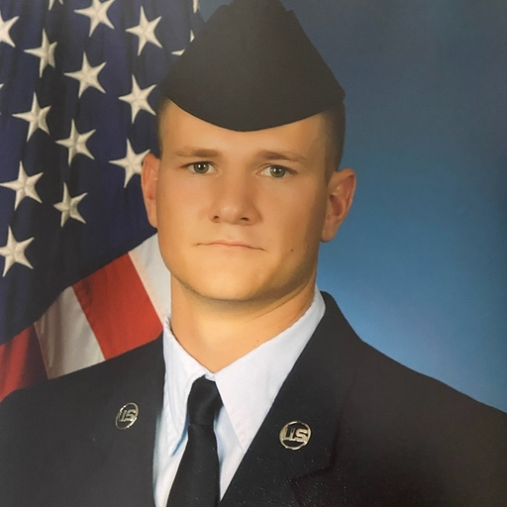
Club/Wingstaff Representatives
Booster: C/Rodriguez
AAS: C/Fanning
Honor Guard: C/Gibson
Victory: C/Graschel
i5: C/Fanning
Silver Wings: C/Kiang
Cadet Colonel Shelby Schrecker
Wing Commander
Cadet Colonel Joshua Davidson
Chief of Staff
Cadet Lt. Colonel Mary Vallor
Deputy Commander of Operations
Cadet Lt. Colonel Cody Funke
Deputy Commander of Combat Support
Cadet Lt. Colonel Connor Griffin
Inspector General
Air Force ROTC Detachment 842 • We Build Exceptional Officers • The University of Texas at San Antonio

Slide 10
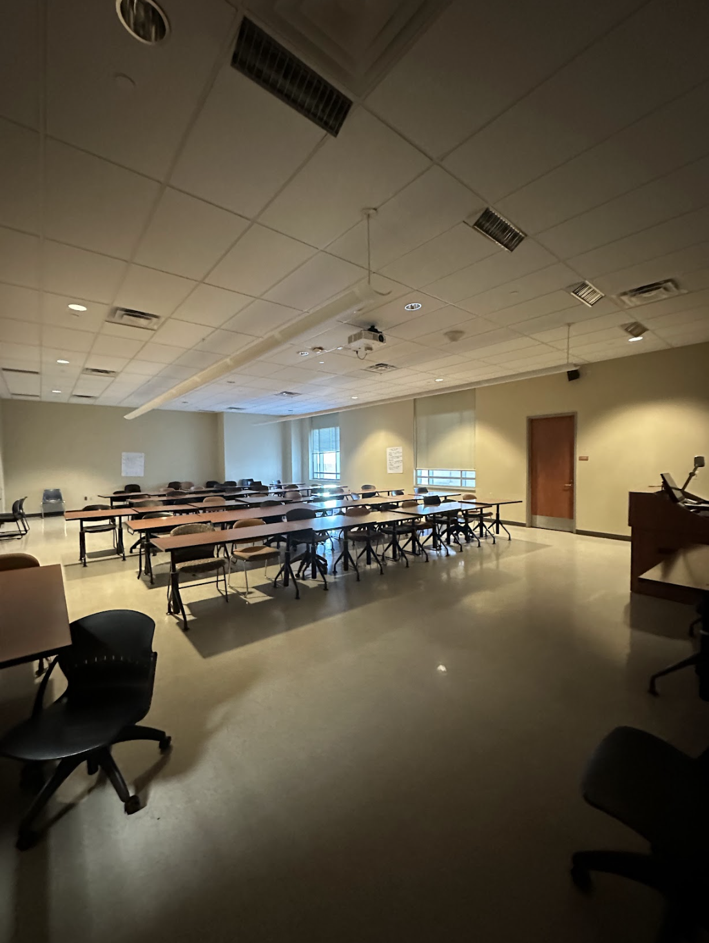
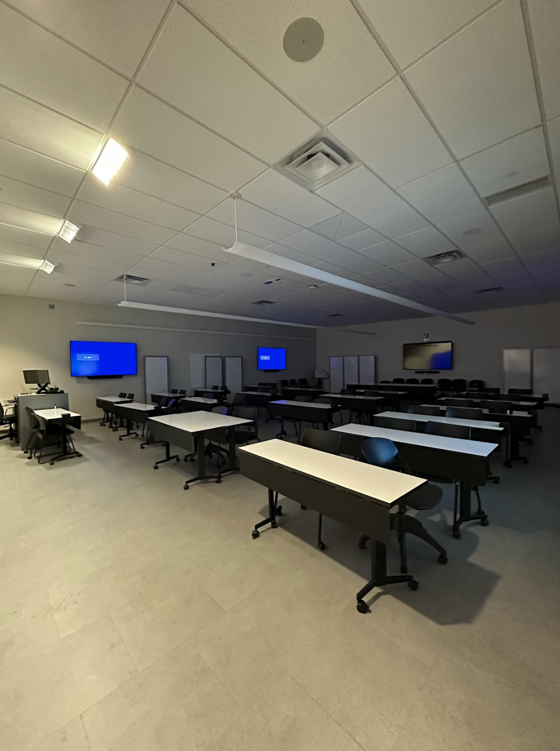
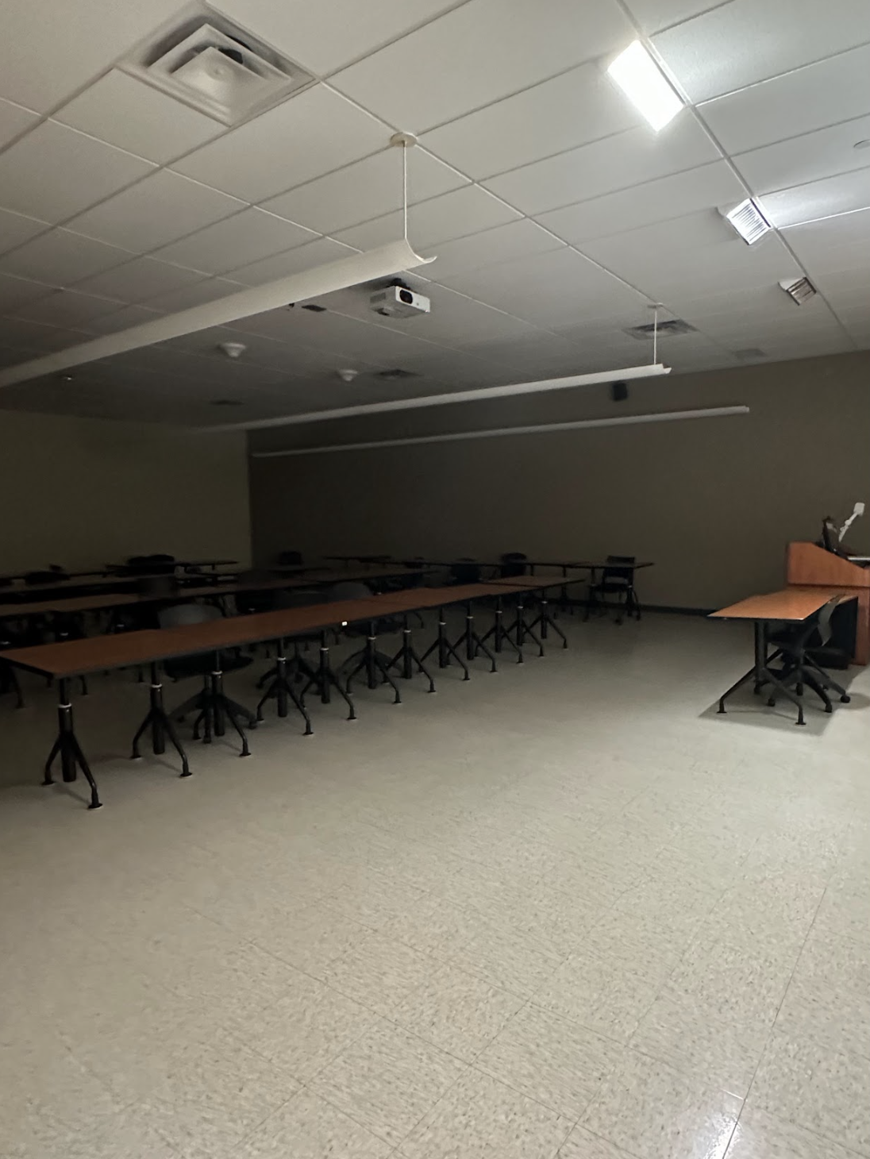
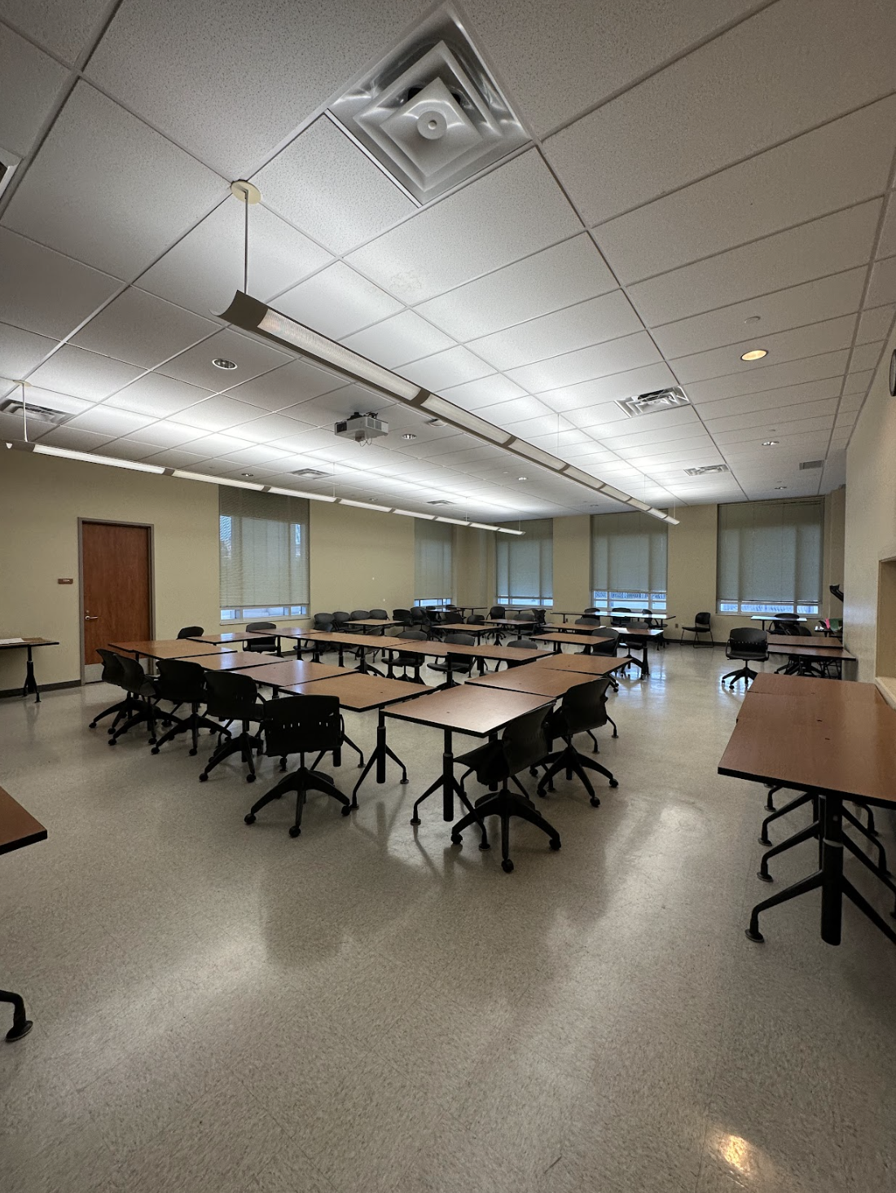
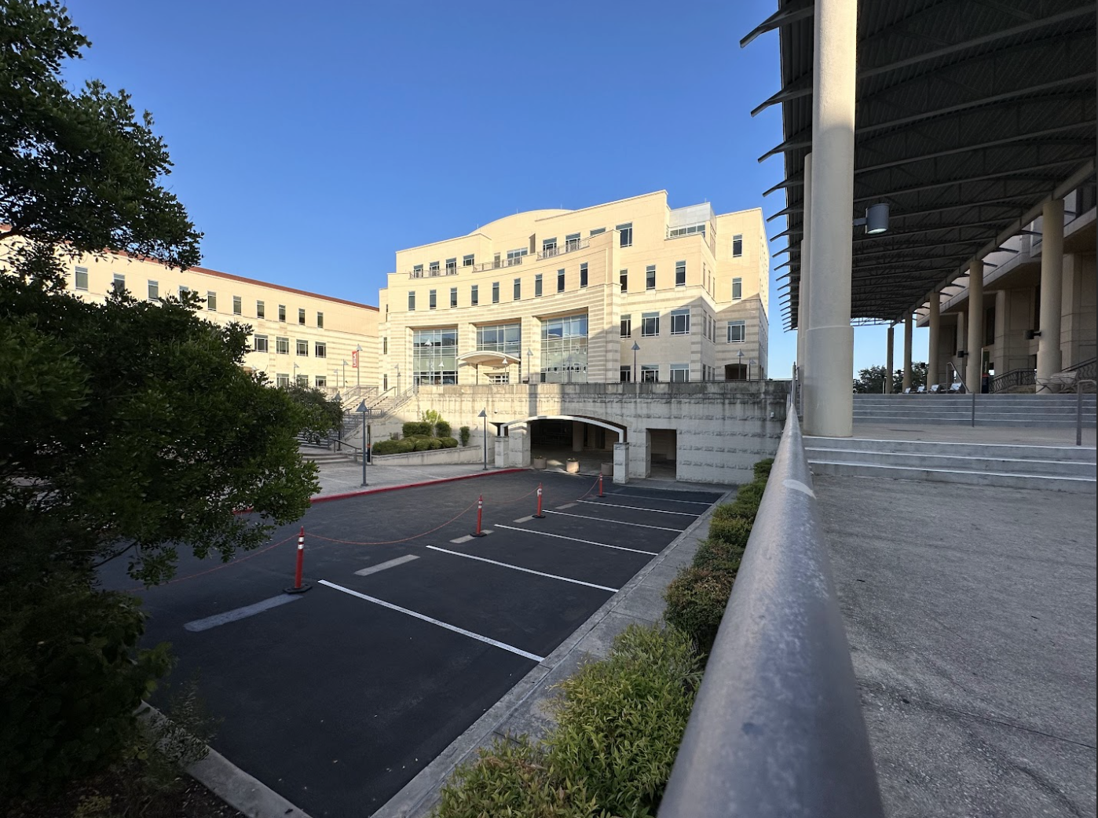
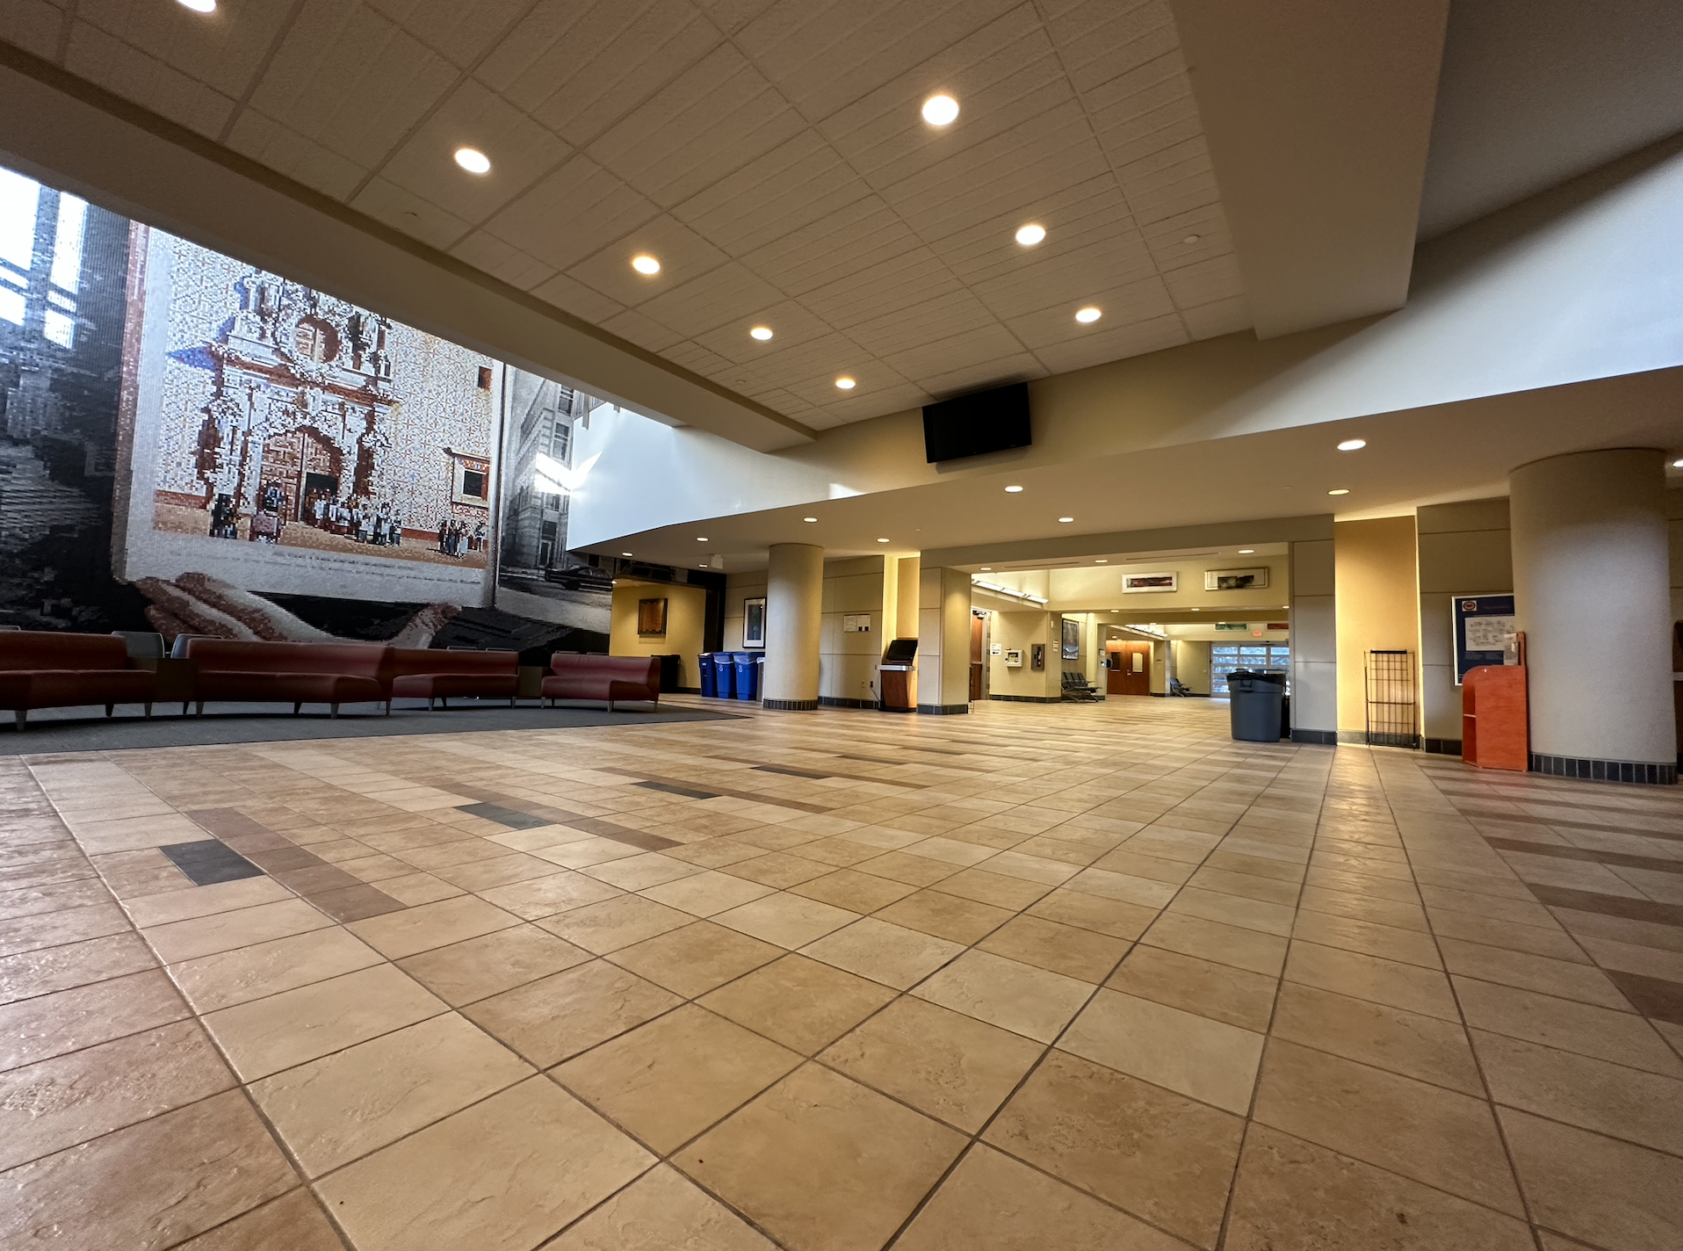
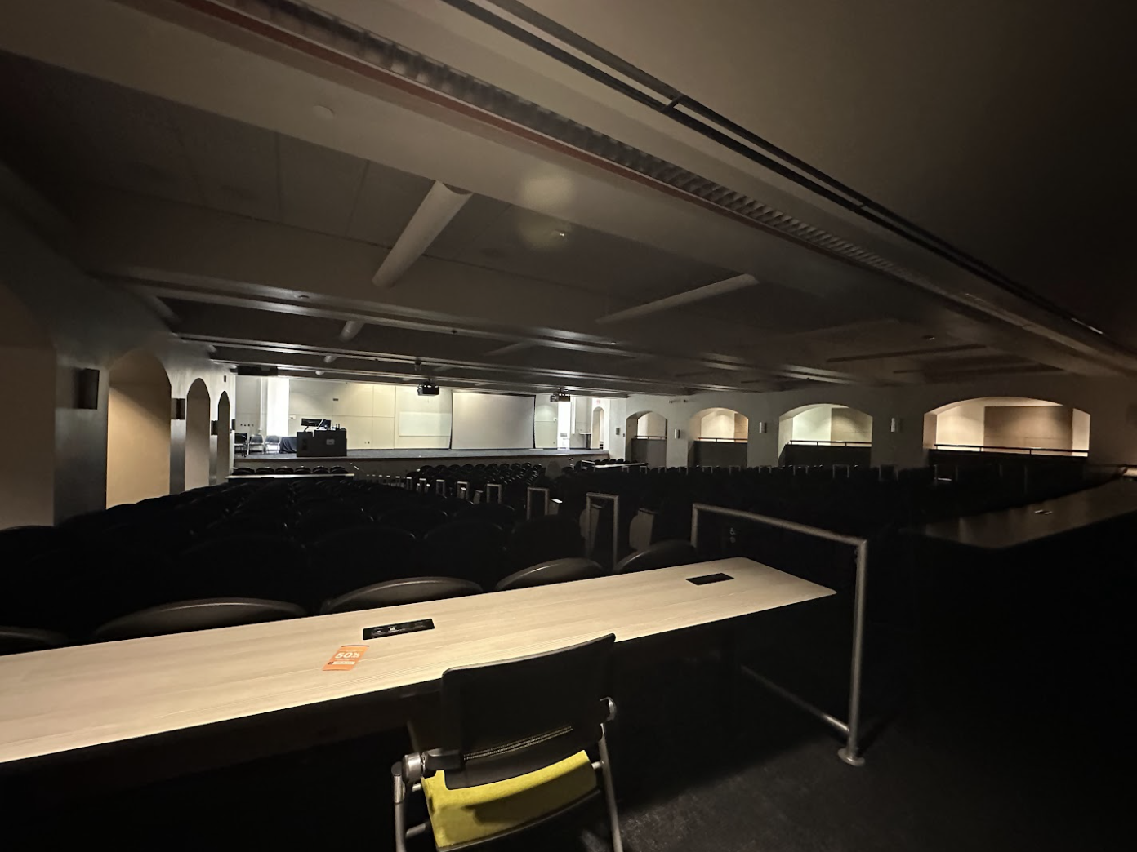
Reserved Rooms
Room 1.126: Waiting Room/GLP
Room 1.124:LRS
Room 1.122:
Sport Physicals
Room 1.120:
Overflow Room
Hallway:
Height/Weight and Check-in
Room 0.104: Right Side auditorium
Main Building

Slide 11
Logistics
Check-In Tables/Chairs
Height and Weight Scales
Wristbands - G, R, P
Dress & Appearance Uniform Posters
Uniforms - Ordered
Signs - Directional, Height and Weight, Physicals, LRS, Slack QR Codes
Paperwork - NSOP Schedules, Maps, Extra Physicals, GLPs
Radios
Snacks - 40 Fruit Snacks, 32 Snack Bars
Waters - 160
Coolers
First Aid Kit
Air Force ROTC Detachment 842 • We Build Exceptional Officers • The University of Texas at San Antonio

Slide 12
Summary
NSOP Schedule
Group Rotations
NSOP Set-Up Visuals
Campus Tour
Leads/Volunteers
Reserved Rooms
Logistics
Summary
Questions
Air Force ROTC Detachment 842 • We Build Exceptional Officers • The University of Texas at San Antonio

Slide 13
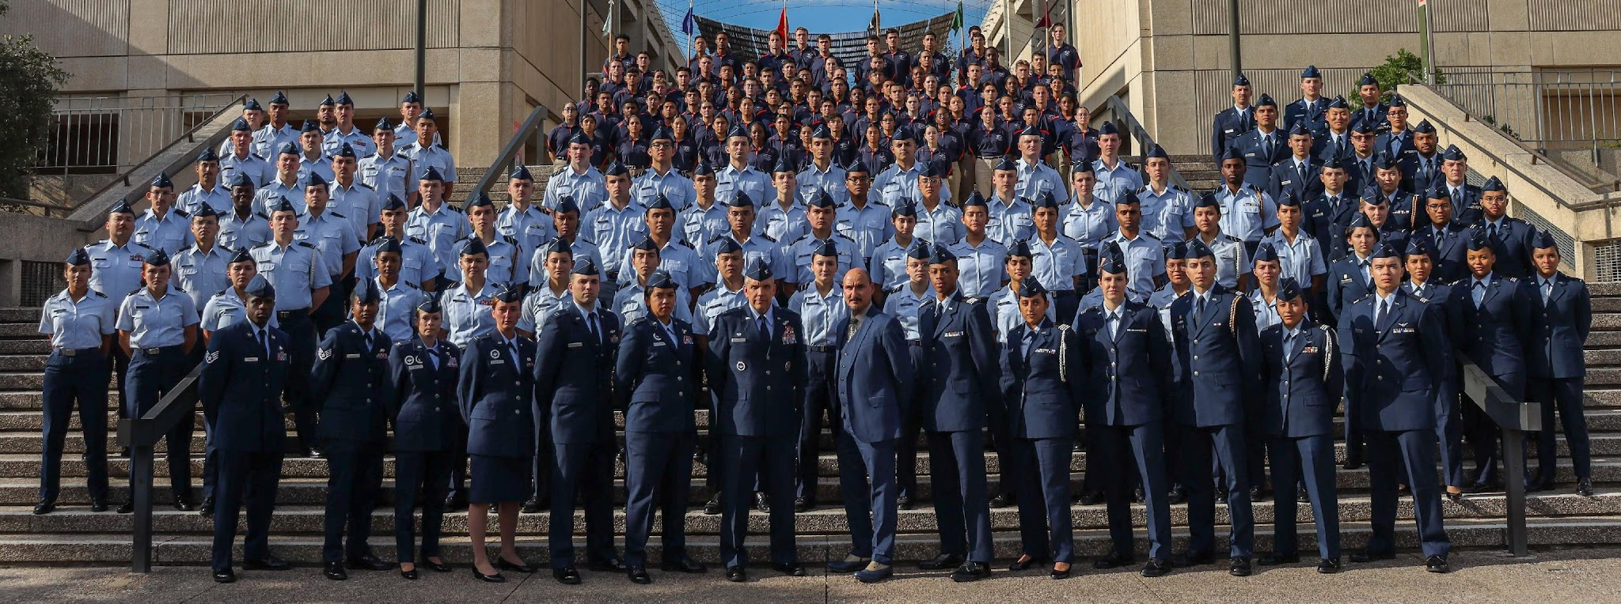
Air Force ROTC Detachment 842
The University of Texas at San Antonio
Det 842 – Best in Blue

